Slide 1
Detection of Deviant Behavior From Agent Traces
Jožef Stefan International Postgraduate School
Boštjan Kaluža Department of Intelligent Systems, Jožef Stefan Institute Jozef Stefan Institute

Slide 2
Introduction: Agent
Agent
Autonomous intelligent entity
Capable of motion and action
Human, robot, computer program
Spatio-temporal traces
Behavior

Slide 3
Introduction: Spatio-Temporal Traces
Agent
Spatio-temporal traces
Vector time series
Position, agent’s state
Behavior

Slide 4
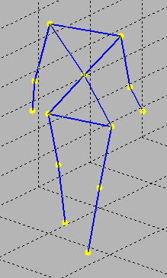
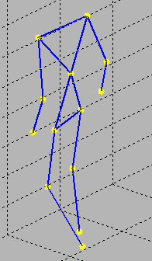
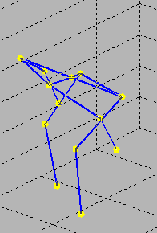
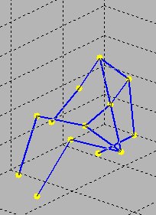
Introduction: Behavior
Agent
Spatio-temporal traces
Behavior
Agent’s responses to various perceptual inputs
Range of activities and mannerisms made by agent in conjunction with its environment, situation, and other agents
Walking
→
→
Walking
→
Sitting down
Sitting

Slide 5
Deviant Behavior Anomalous and Suspicious
Deviant behavior:
Occurs infrequently, consequences quite dramatic
Security risk, health problem, or abnormal behavior contingency
Anomalous behavior
Cannot be matched against positive behavior patterns
Suspicious behavior
Matches negative behavior patterns
+
+
+
+
+
+
+
o
+
+
+
+
-
-
-
-
o
-
-
-
-
-
-
-

Slide 6
Problem Statement
How to obtain behavior deviation degree from agent’s spatio-temporal traces?
How to recognize activities?
How to represent complex, real-life behavior?
Behavior may reflect on different time scales and modalities
Single behavior evaluation might not be sufficient
Notes:
Likelihood that the observed behavior does not conform to the desired behavior or matches unwanted behavior

Slide 7
Outline
The unified detection framework
Behavior signatures
Empirical study: ambient assisted living
Conclusion

Slide 8
Unified Detection Framework: Abstraction Levels
Measurements
Abstraction level
Agent’s traces in the environment
Sensors
Observations
Activity assessment
Activity recognition
Noise removal
Activity feature vector
Atomic activity recognition
Spurious activity removal
Recognition of complex activities / agent-agent interaction
Behavior assessment
Deviant behavior detection
Behavior trace
Behavior pattern
Deviant behavior detectors
Combining multi-view detectors
Deviant behavior accumulation
Behavior evaluation

Slide 9
Start
Agent’s traces in the environment
Unified Detection Framework: Processing Flow Chart
Activity recognition pipeline
Activity trace
Deviant
behavior
detection
Behavior trace construction
Behavior trace
View 1
transform
View 2
transform
…
View n transform
Behavior signature
Behavior signature
Behavior signature
…
Deviant behavior detection
Deviant behavior detection
Deviant behavior detection
…
Combining multi-view detectors
Accumulating deviant behavior over time
Degree of deviation
End

Slide 10
Outline
Start
The unified detection framework
Behavior signatures
Motivation
Spatio-activity matrix
Visualization
Feature extraction and anomaly detection
Empirical study
Conclusion
Agent’s traces in the environment
Activity recognition pipeline
Activity trace
Deviant
behavior
detection
Behavior trace construction
Behavior trace
View 1
transform
View 2
transform
…
View n transform
Behavior signature
Behavior signature
…
Behavior signature
Deviant behavior detection
Deviant behavior detection
…
Deviant behavior detection
Combining multi-view detectors
Accumulating deviant behavior over time
Degree of deviation
End

Slide 11
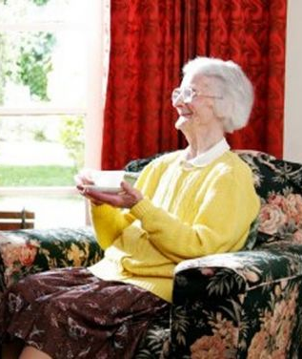
Behavior Signatures: Motivation
Goal:
Analyze agent’s spatial-activity patterns
Discover anomalies
Example: An elderly person at home
Analyze person’s daily-living patterns
Detect physical or mental degradation

Slide 12
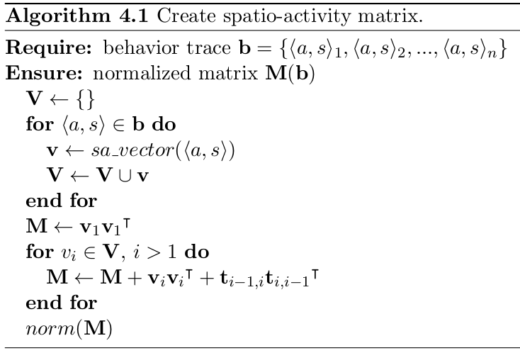
Behavior Signatures: Spatio-Activity Matrix
Input
Spatio-activity vectors
Matrix construction
Matrix normalization

Slide 13
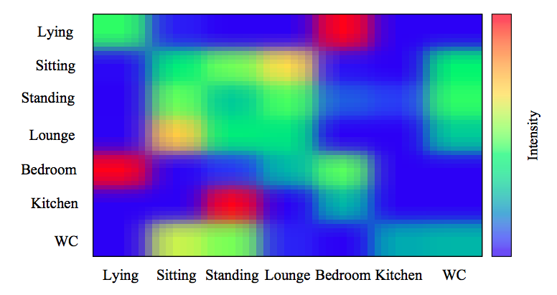
Behavior Signatures: Spatio-Activity Matrix
Activity: | Standing | Standing | Standing | Sitting | Sitting | Lying
Room: | Kitchen | Kitchen | Bedroom | Bedroom | Bedroom | Bedroom
Activity-Activity
Activity-Spatial
Spatial-Activity
Spatial-Spatial

Slide 14
Behavior Signatures: Spatio-Activity Matrix
Activity: | Standing | Standing | Standing | Sitting | Sitting | Lying
Room: | Kitchen | Kitchen | Bedroom | Bedroom | Bedroom | Bedroom
 |  | 1 |  |  | 1
 |  | 1 |  |  | 1

Slide 15
Behavior Signatures: Spatio-Activity Matrix
Activity: | Standing | Standing | Standing | Sitting | Sitting | Lying
Room: | Kitchen | Kitchen | Bedroom | Bedroom | Bedroom | Bedroom
 |  | 2 |  |  | 2
 |  | 2 |  |  | 2

Slide 16
Behavior Signatures: Spatio-Activity Matrix
Activity: | Standing | Standing | Standing | Sitting | Sitting | Lying
Room: | Kitchen | Kitchen | Bedroom | Bedroom | Bedroom | Bedroom
 |  | 3 |  | 1 | 2
 |  | 1 |  | 1
 |  | 2 |  | 1 | 2

Slide 17
Behavior Signatures: Spatio-Activity Matrix
Activity: | Standing | Standing | Standing | Sitting | Sitting | Lying
Room: | Kitchen | Kitchen | Bedroom | Bedroom | Bedroom | Bedroom
 | 1 |  |  | 1
 | 1 | 3 |  | 1 | 2
 | 1 | 1 |  | 2
 |  | 2 |  | 1 | 2

Slide 18
Behavior Signatures: Spatio-Activity Matrix
Activity: | Standing | Standing | Standing | Sitting | Sitting | Lying
Room: | Kitchen | Kitchen | Bedroom | Bedroom | Bedroom | Bedroom
 | 2 |  |  | 2
 | 1 | 3 |  | 1 | 2
 | 2 | 1 |  | 3
 |  | 2 |  | 1 | 2

Slide 19
Behavior Signatures: Spatio-Activity Matrix
Activity: | Standing | Standing | Standing | Sitting | Sitting | Lying
Room: | Kitchen | Kitchen | Bedroom | Bedroom | Bedroom | Bedroom
1 |  |  |  | 1
1 | 2 |  |  | 2
 | 1 | 3 |  | 1 | 2
1 | 2 | 1 |  | 4
 |  | 2 |  | 1 | 2

Slide 20
Behavior Signatures: Spatio-Activity Matrix
Normalize matrix by region
Activity-Activity
1 |  |  |  | 1
1 | 2 |  |  | 2
 | 1 | 3 |  | 1 | 2
1 | 2 | 1 |  | 4
 |  | 2 |  | 1 | 2
Activity-Spatial
Spatial-Activity
Spatial-Spatial

Slide 21
Behavior Signatures: Visualization
An example of normalized matrix

Slide 22
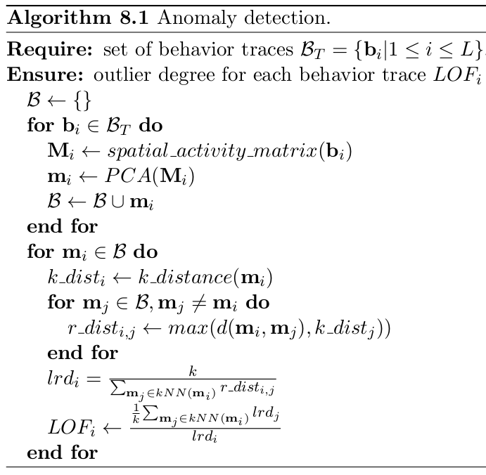
Behavior Signatures: Feature Extraction and Anomaly Detection
Anomaly degree for each b_{i}
Compute spatio-activity matrix
and principal components
Detect outliers with density-based k-NN
(Local Outlier Factor)

Slide 23
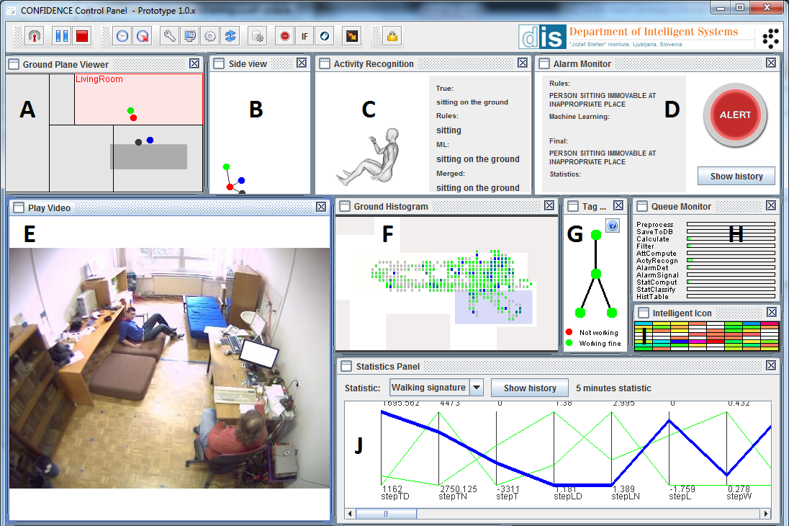
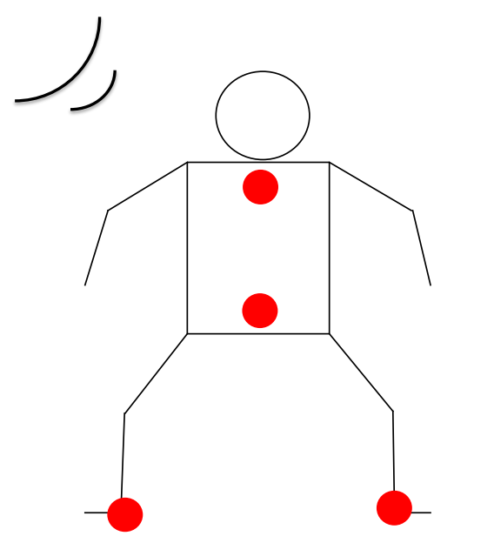
Empirical Studies – AAL Domain: Introduction
User lives at home alone
We observe 3D coordinates of the body
Task: detect anomalous changes in behavior that indicate health problem
B. Kaluža and M. Gams. Analysis of Daily-Living Dynamics. Journal of Ambient Intelligence and Smart Environments, 2012. M. Luštrek and B. Kaluža. Fall Detection and Activity Recognition with Machine Learning. Informatica, 2009.

Slide 24
Start
Empirical Studies – AAL Domain: Instantiated Unified Framework
Person’s coordinates in the apartment
Activity recognition: ARPipe
Activity trace
Deviant
behavior
detection
Behavior trace: activity trace + landmark
Behavior trace
Spatial-activity matrix: Full day
Behavior signature
Deviant behavior detection:
PCA + LOF
No combination of multi-view detectors
No accumulation of deviant behavior over time
Degree of deviation
End

Slide 25
Empirical Studies – AAL Domain: Results
Two users in the office, one month of data
Spatio-activity successfully discriminates anomalous days
B. Kaluža, M. Gams. An Approach to Analysis of Daily Living Dynamics International Conference on Machine Learning and Data Analysis 2010, San Francisco, USA, 20-22 October, 2010

Slide 26
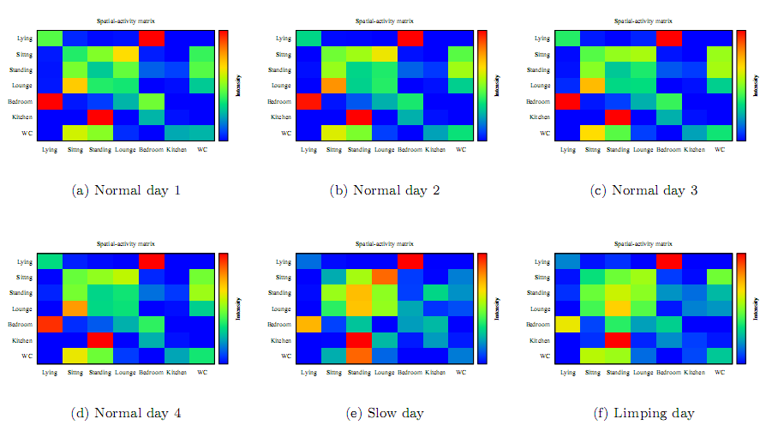
Empirical Studies – AAL Domain: Results: Visualization

Slide 27
Empirical Studies – AAL Domain: Results: Principal Components

Slide 28
Conclusion: Summary
Framework for deviant behavior detection
Activity recognition
Multiple time spans and modalities
Behavior signatures
Behavior dynamics in spatio-activity space
Accumulation over time
Empirical study on AAL domain

